Slide 1



Predictive Analysis – Electrical car
Yousof Rahimian Master of Data Science Bellevue University DSC 630 T302 (Individual Course Project) Fall,2022

Slide 2

What is an Electric Car?
An electric car, battery electric car, or all-electric car is an automobile that is propelled by one or more electric motors, using only energy stored in batteries. Compared to internal combustion engine (ICE) vehicles, electric cars are quieter, have no exhaust emission, and lower emissions overall.
ne or more electric motors, using only energy stored in batteries. Compared to internal combustion engine (ICE) vehicles, electric cars are quieter, have no exhaust emission, and lower emissions overall.

Slide 3
Project Overview
I am going to build a machine learning model to make this task automated with the best accuracy possible using python.
I will build a model that can predict how does price of cars relate to variables and find out the more important of item on price?

Slide 4
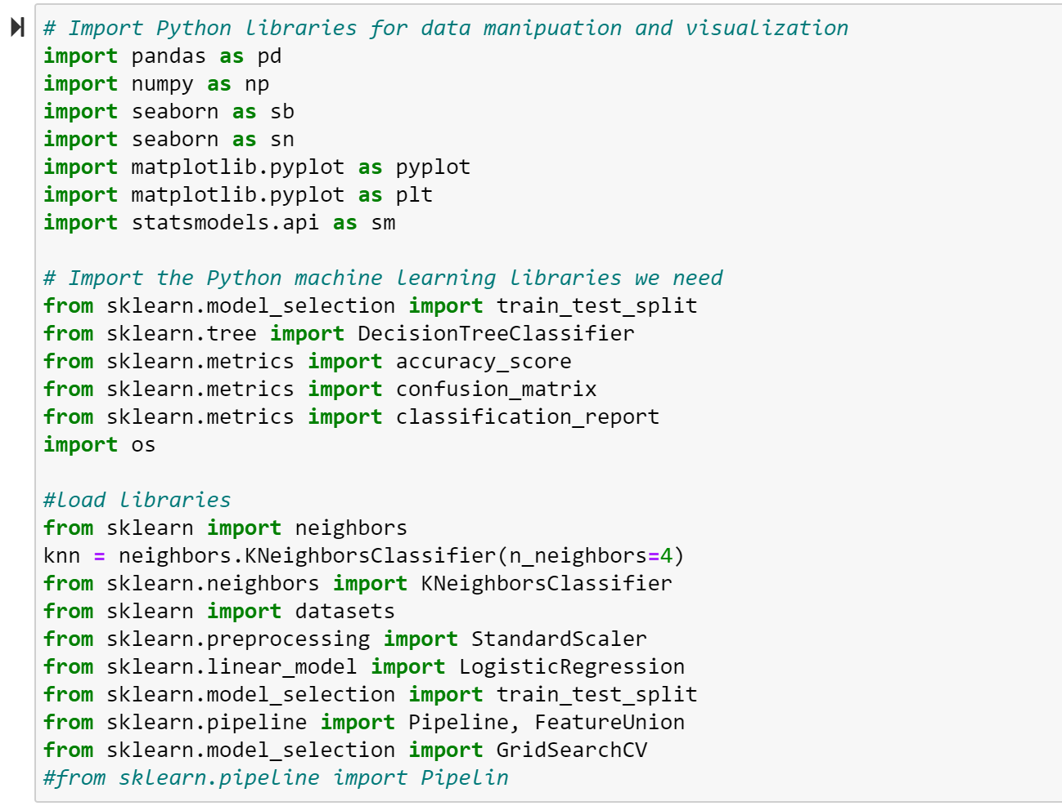
Packages

Slide 5
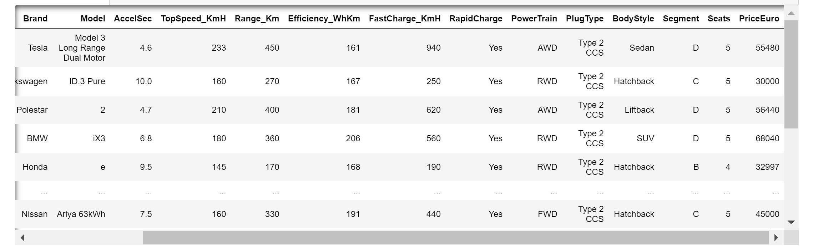
Prepare the data for modeling by performing the following steps:

Slide 6
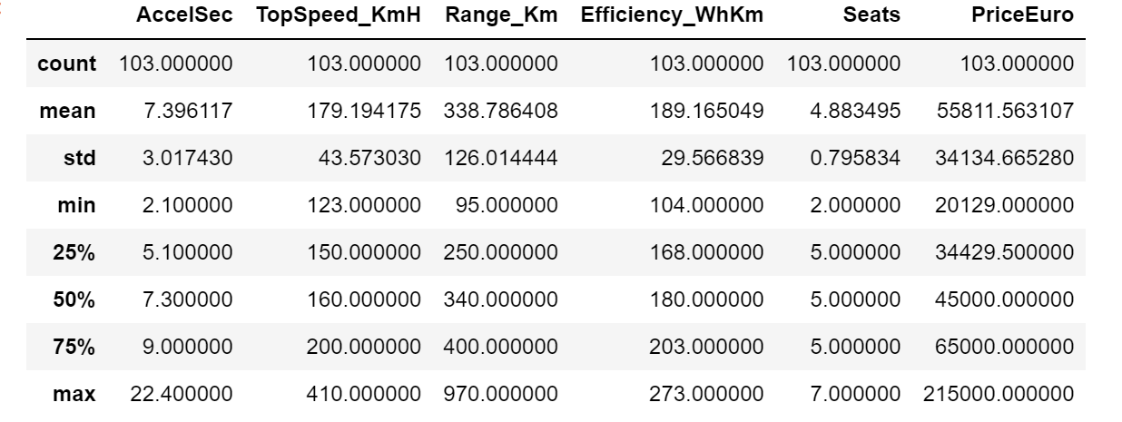
Descriptive Statistics of the dataset

Slide 7
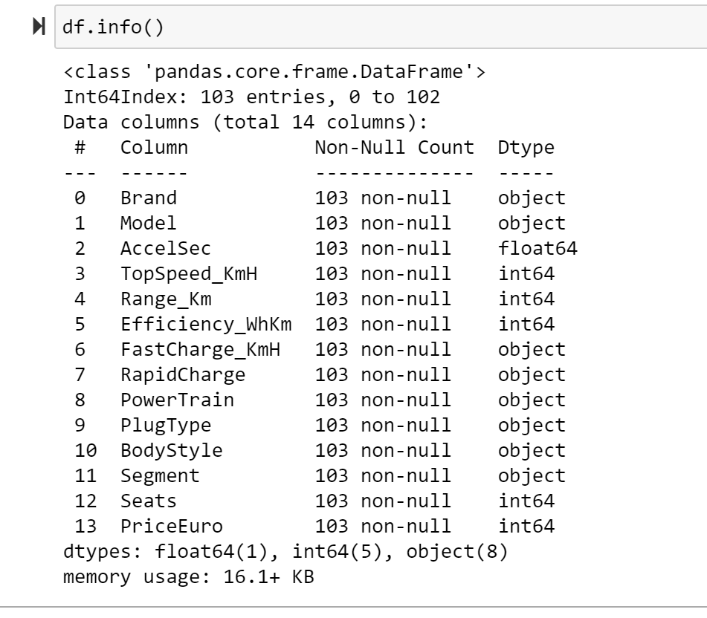
Information of the type of data in each column

Slide 8
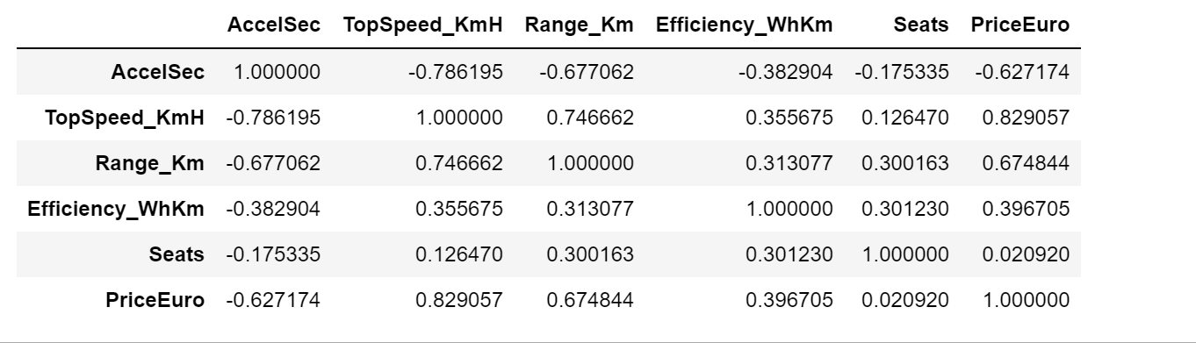
correlation between the variables

Slide 9
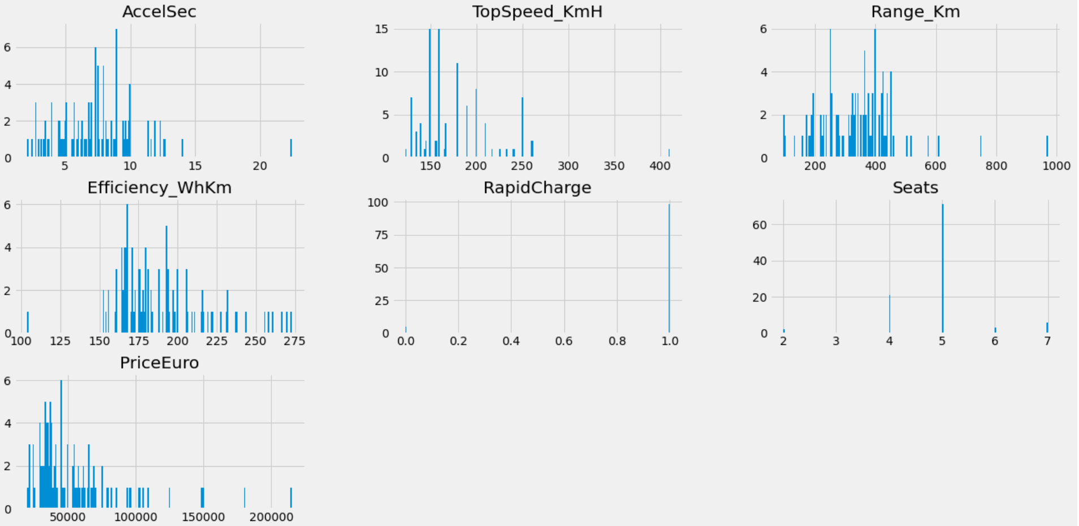
Histogram of Numerical

Slide 10
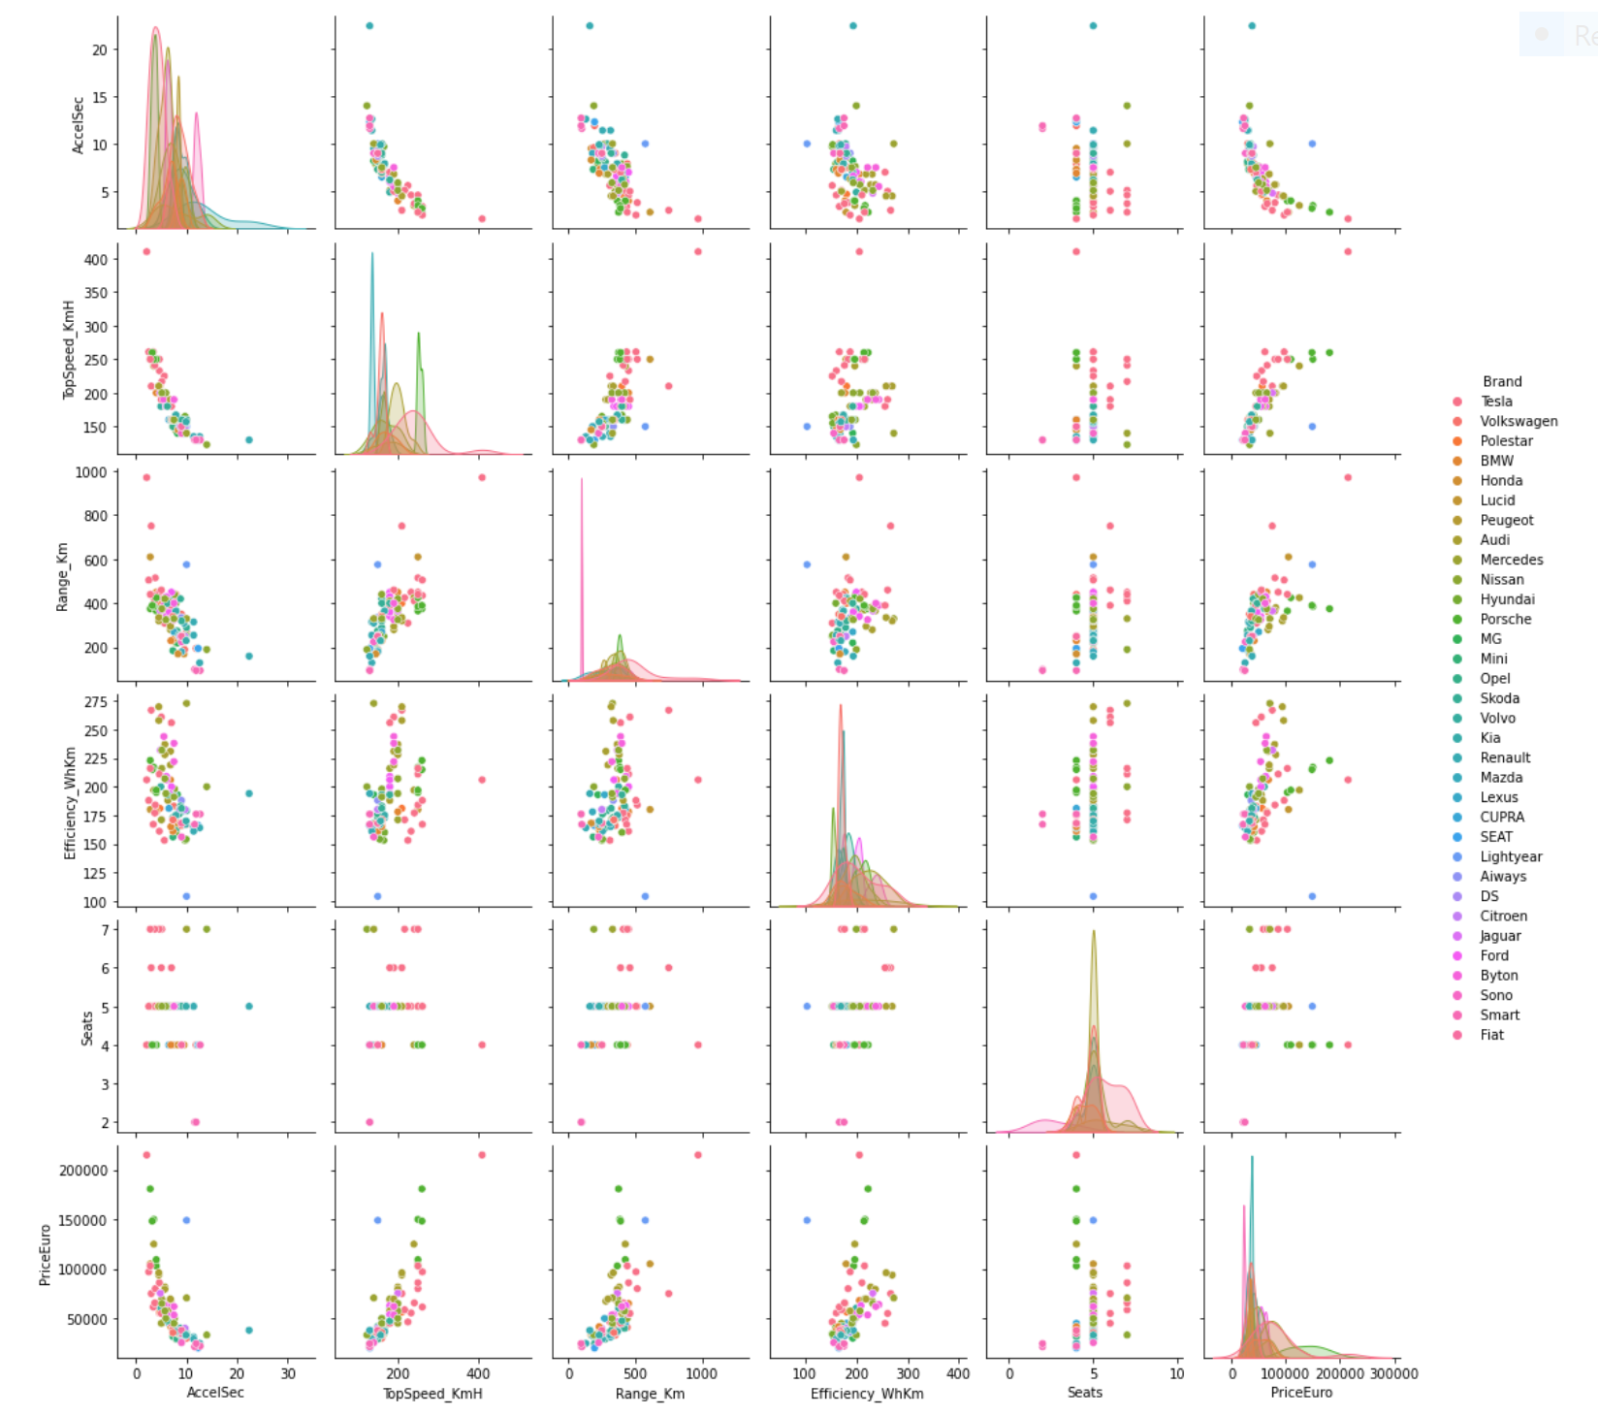
Pair plot of all the columns based on Brand presence

Slide 11
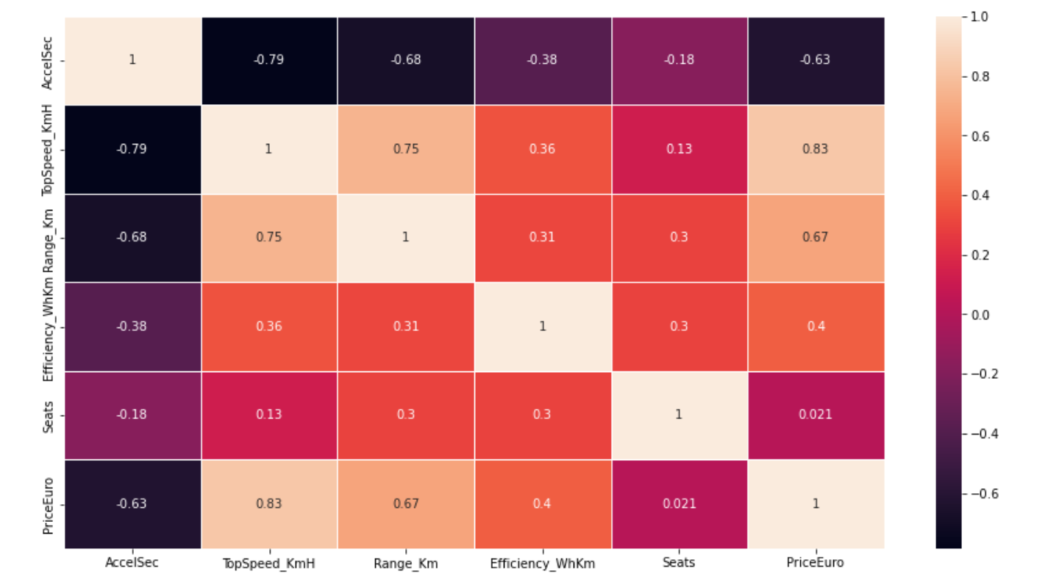
Heatmap to show the correlation of the data

Slide 12
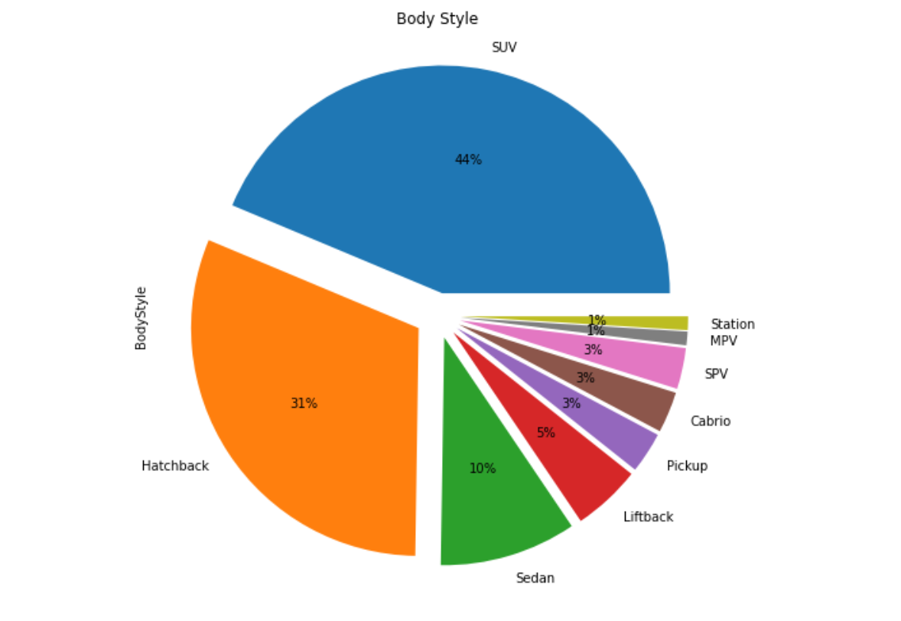
Cars and their body style

Slide 13
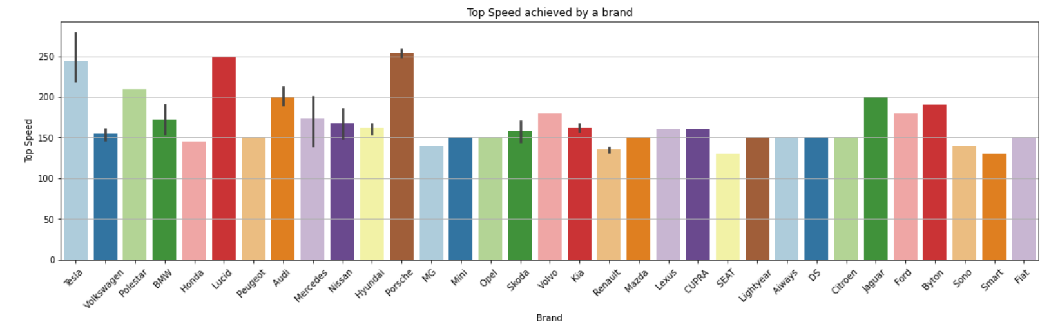
Top speeds achieved by the cars of a brand

Slide 14
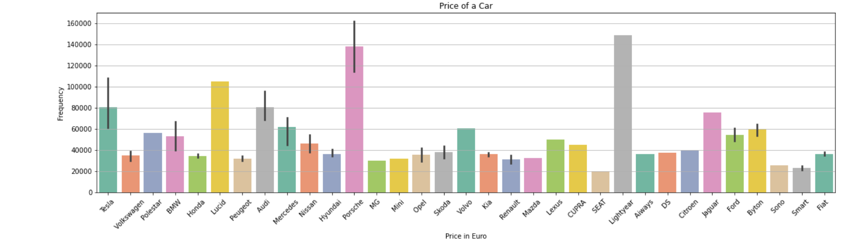
Price of cars (in Euro)

Slide 15
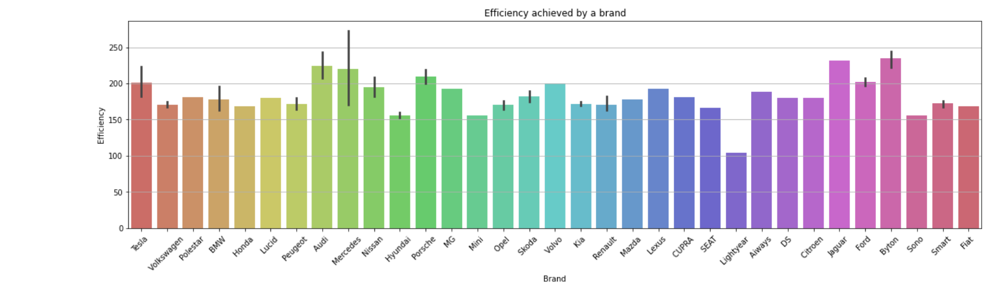
Car efficiency

Slide 16
Build and evaluate the models
linear Regression using OLS method
- Split the data into a training and test set, where the “PriceEuro” column is the target.

Slide 17
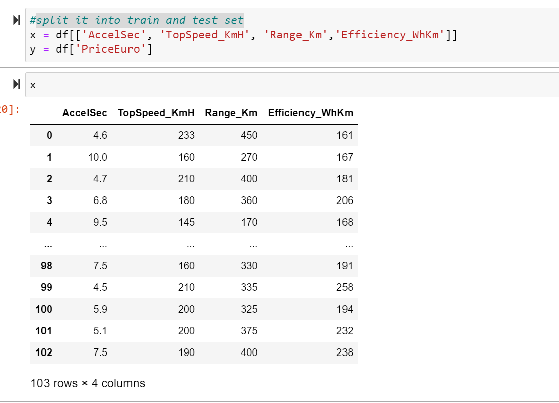
split it into train and test set

Slide 18
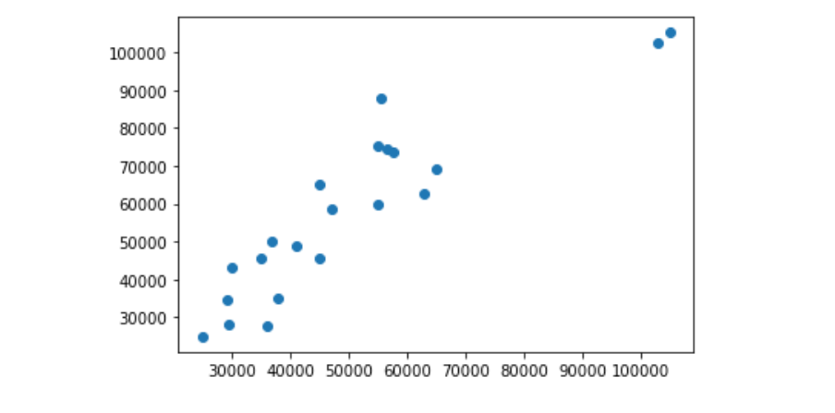
Run a linear regression and report the R2-value and RMSE on the test set.

Slide 19
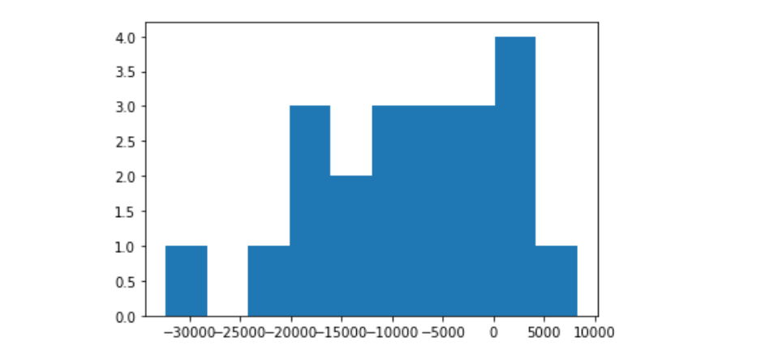
Another way to visually assess the performance of our model

Slide 20
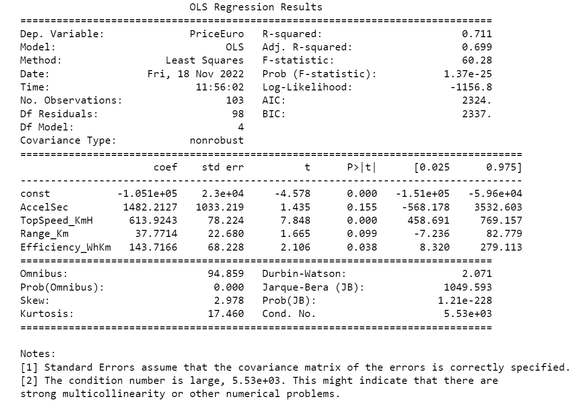
Calculate R2

Slide 21
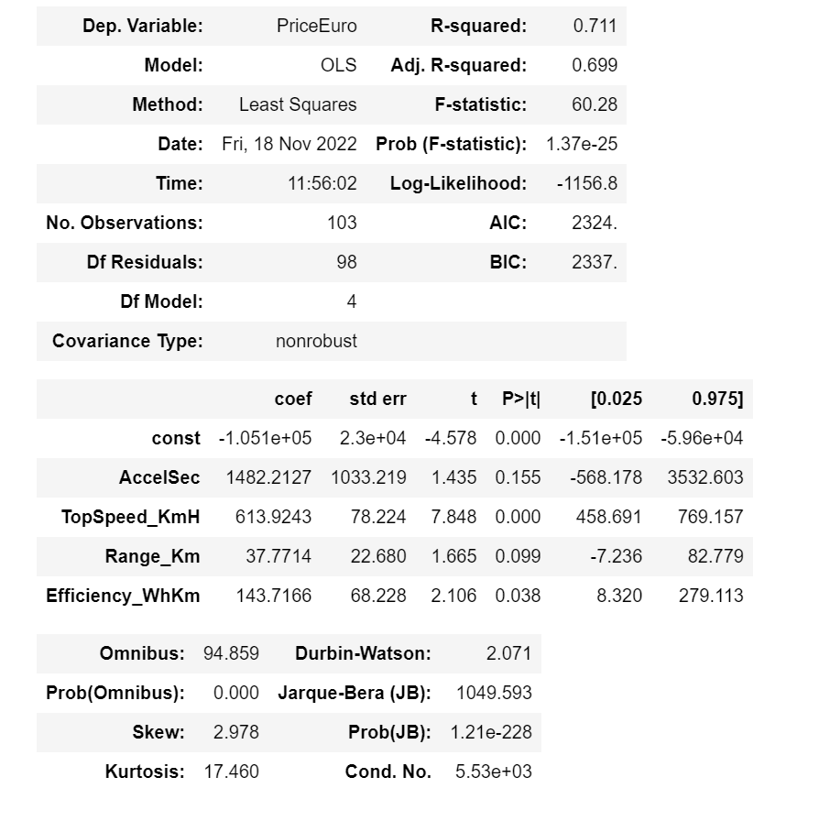
logistic regression model

Slide 22
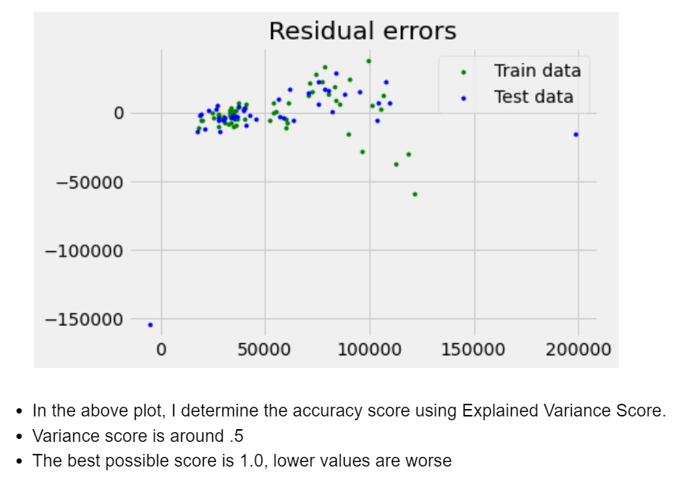
Linear regression

Slide 23
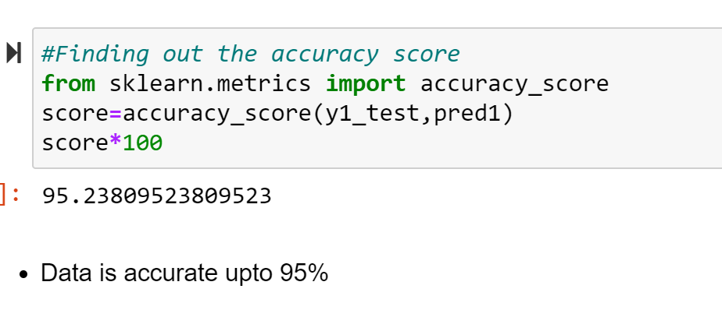
Data Accuracy

Slide 24
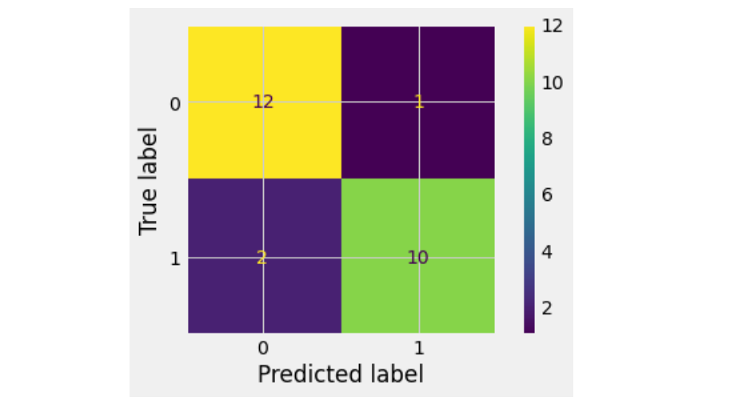
Confusion Matrix

